Slide 1
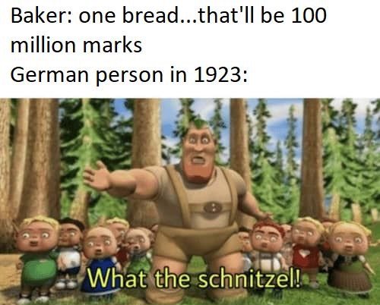
History Heroes
Week 7

Slide 2
Question 1: What did Hitler believe the ideal Aryan looked like? (2 marks)

Slide 3
Question 2: What is eugenics? (1 mark)

Slide 4
Question 3: There were two laws passed under what is known as ‘the Nuremberg Laws’, what are they called? (2 marks)

Slide 5
Question 4: on what date were the Nuremberg Laws passed? (3 marks – day, month, year)

Slide 6
Question 5: What is another name for Kristallnacht? (1 mark)

Slide 7
Question 6: On what date did Kristallnacht occur? (3 marks – days, month, year)

Slide 8
Question 7: What was Kristallnacht? (1 mark)

Slide 9
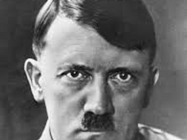
ANSWERS

Slide 10
Question 1: What did Hitler believe the ideal Aryan looked like? (2 marks)
Blond hair
Blue eyes
Tall
Strong

Slide 11
Question 2: What is eugenics? (1 mark)
The science of improving a population by controlled breeding to increase the occurrence of desirable heritable characteristics.

Slide 12
Question 3: There were two laws passed under what is known as ‘the Nuremberg Laws’, what are they called? (2 marks)
The Reich Citizenship Law
The Law for the Protection of German Blood and German Honour

Slide 13
Question 4: on what date were the Nuremberg Laws passed? (3 marks – day, month, year)
15th September 1935

Slide 14
Question 5: What is another name for Kristallnacht? (1 mark)
The Night of Broken Glass

Slide 15
Question 6: On what date did Kristallnacht occur? (3 marks – days, month, year)
November 9–10, 1938

Slide 16
Question 7: What was Kristallnacht? (1 mark)
The vandalism and destruction of Jewish-owned businesses, synagogues, and homes in Germany.
30,000 Jewish males were rounded up and taken to concentration camps.

Slide 17
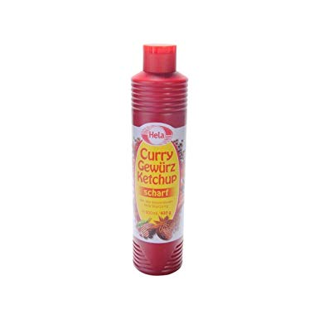
Source of the week

Slide 18
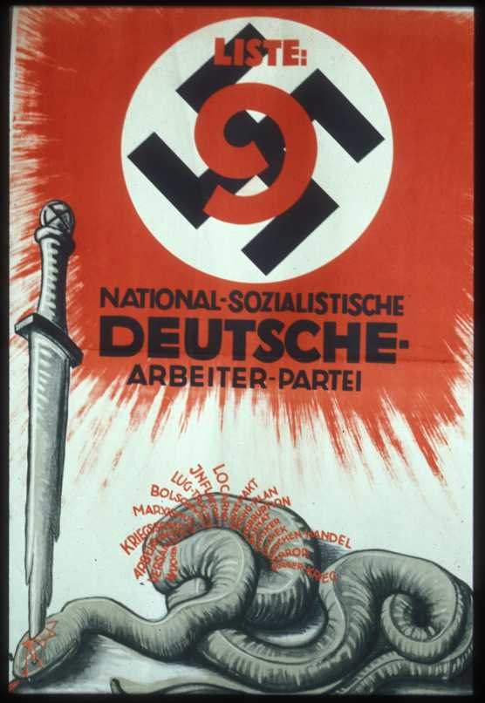
September 1930 Reichstag election.
The red words coming from the snake are: usury, Versailles, unemployment, war guilt lie, Marxism, Bolshevism, lies and betrayal, inflation, Locarno, Dawes Pact, Young Plan, corruption, Barmat, Kutistker, Sklarek [the last three Jews involved in major financial scandals], prostitution, terror, civil war.

